Slide 1
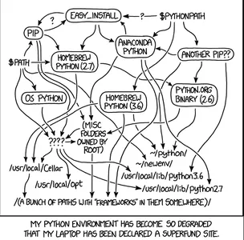
Module 1: Environment Mastery & Path Architecture
Move beyond basic script execution to understanding the underlying operating system linkages, dependency isolation, and dynamic path routing required for scalable architecture.
Presented By: Zaryab Ahmad

Slide 2

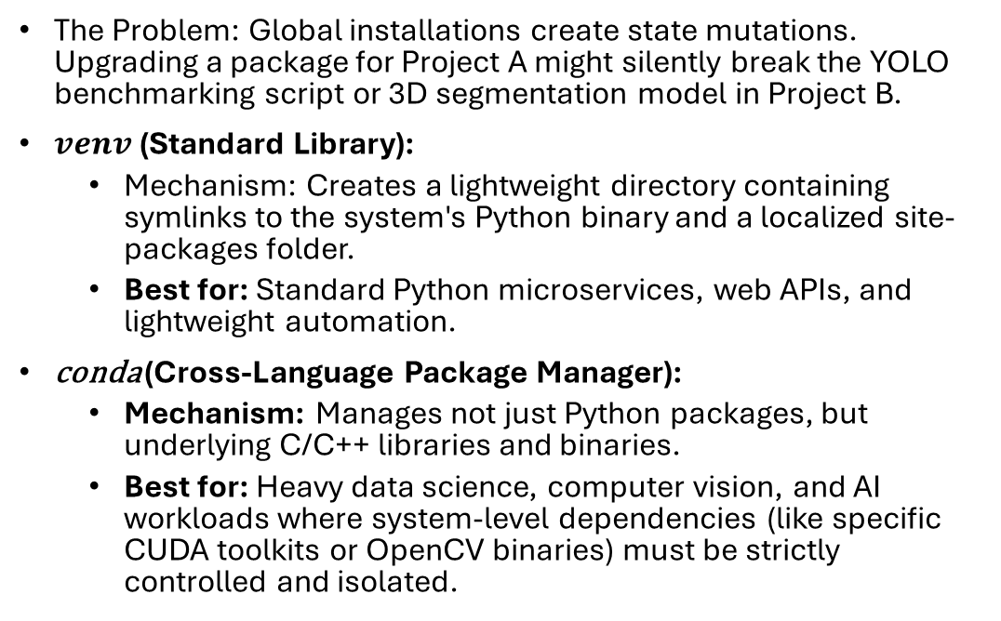

Virtual Environments: $venv$ vs. conda
The Problem: Global installations create state mutations. Upgrading a package for Project A might silently break the YOLO benchmarking script or 3D segmentation model in Project B.
$venv$ (Standard Library):
Mechanism: Creates a lightweight directory containing symlinks to the system's Python binary and a localized site-packages folder.
Best for: Standard Python microservices, web APIs, and lightweight automation.
conda (Cross-Language Package Manager):
Mechanism: Manages not just Python packages, but underlying C/C++ libraries and binaries.
Best for: Heavy data science, computer vision, and AI workloads where system-level dependencies (like specific CUDA toolkits or OpenCV binaries) must be strictly controlled and isolated.

Slide 3


The Global $PATH$ & OS Handoff
Concept: The Operating System does not inherently know what Python is. It only knows how to search.
The $PATH Variable: An ordered list of directories the OS scans when a command is executed in the terminal.
Execution Hierarchy: If you type python, the OS executes the first matching binary it finds in the $PATH order.
Troubleshooting "Command Not Found": This error rarely means Python isn't installed; it means the executable's directory is missing from the system's $PATH variable.

Slide 4
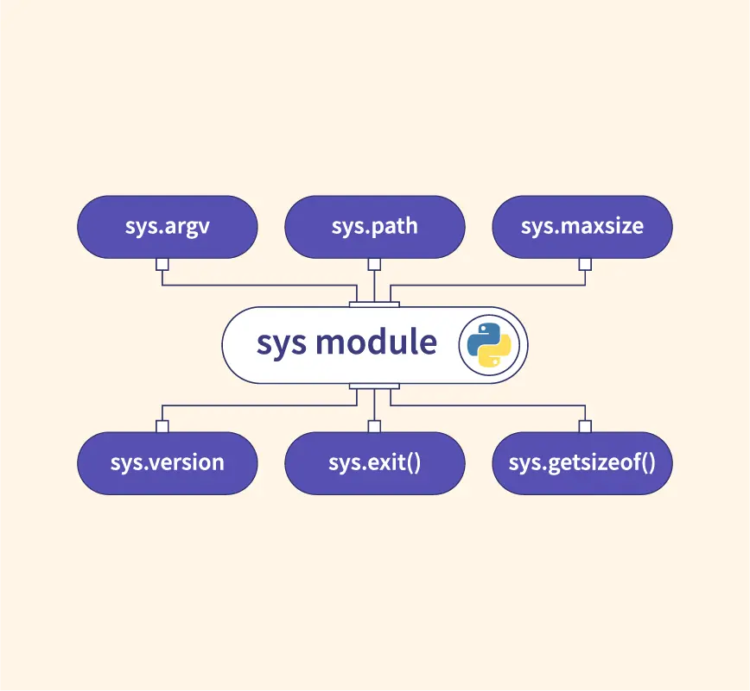
Python's Internal Routing (sys.path)
Concept: Once the OS finds Python, how does Python find your code?
The Resolution Order: When you run import my_module, Python searches exactly in this order:
The directory containing the input script (Current Working Directory).
PYTHONPATH (an environment variable you can set to point to custom libraries).
Standard library directories (e.g., math, os).
site-packages (where pip or conda installs third-party tools).
Architectural Impact: Understanding this order allows developers to structure repositories properly (e.g., separating src/, tests/, and data/ directories) without relying on fragile relative imports.

